Slide 1
Network layer and internet protocol

Slide 2
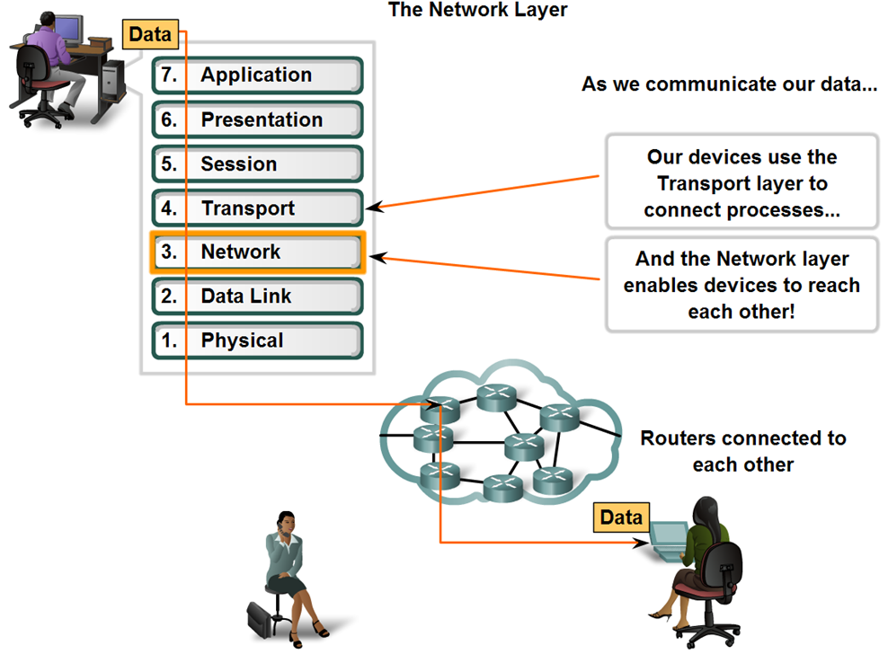
What is Network Layer?
Network Layer provides services to exchange the individual pieces of data over the network between identified end devices.
It uses 4 processes:
Addressing
Encapsulation
Routing
Decapsulation

Slide 3
Functions of the network layer
The Three main Functions of network layer are :
1.Connectionless communication
2.Host addressing
3.Message forwarding

Slide 4
Internet Protocols

Slide 5
Internet Protocols
IP Sec
IPsec was originally planned as part of the next-generation IP (IPv6), but security quickly became very important, and IPsec was designed as the Internet security protocol for both IPv4 and IPv6
IPsec is a integral part of IPv6.
Used move to IPv6 packet headers.

Slide 6
Internet Protocols
Protocols implemented at the Network layer that carry user data include:
Internet Protocol version 4 (IPv4)
Internet Protocol version 6 (IPv6)
Novell Internetwork Packet Exchange (IPX)
AppleTalk
Connectionless Network Service (CLNS/DECNet)

Slide 7
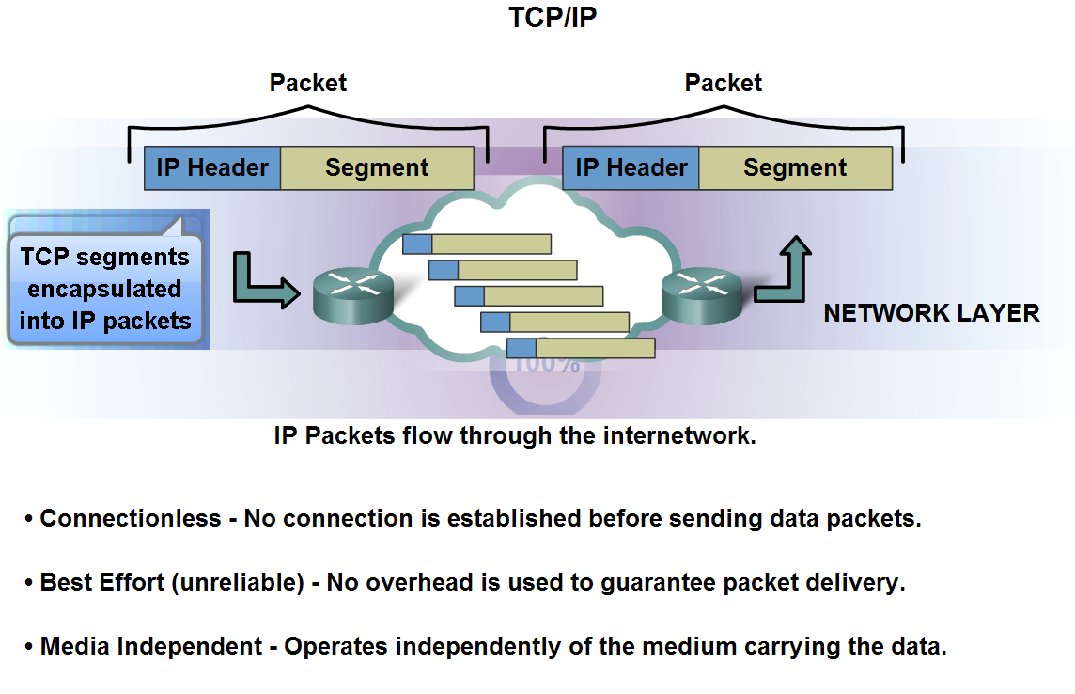
Internet Protocol (IP)
The basic characteristics and the role of the IPv4 protocol:Connectionless, best effort, Media independent

Slide 8
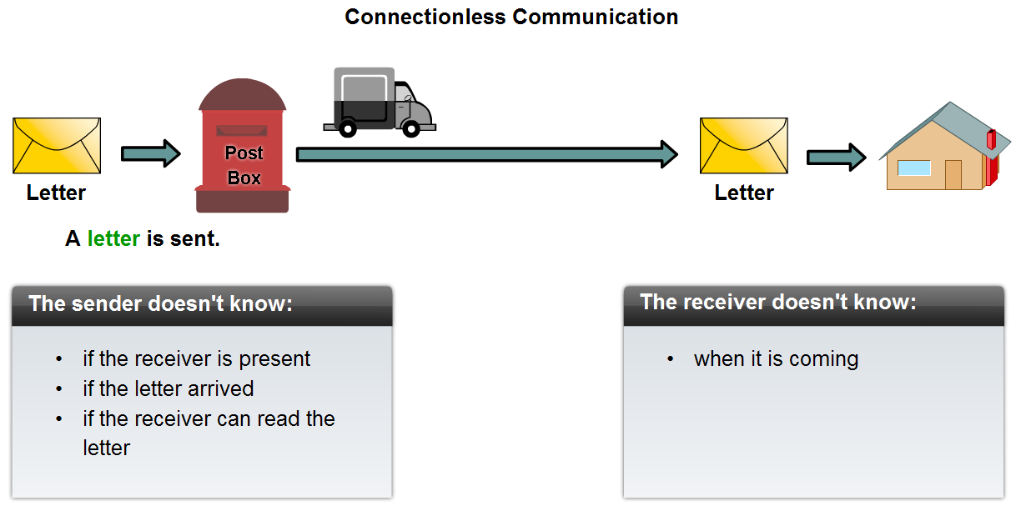
Internet Protocol (IP)
Connectionless Service

Slide 9
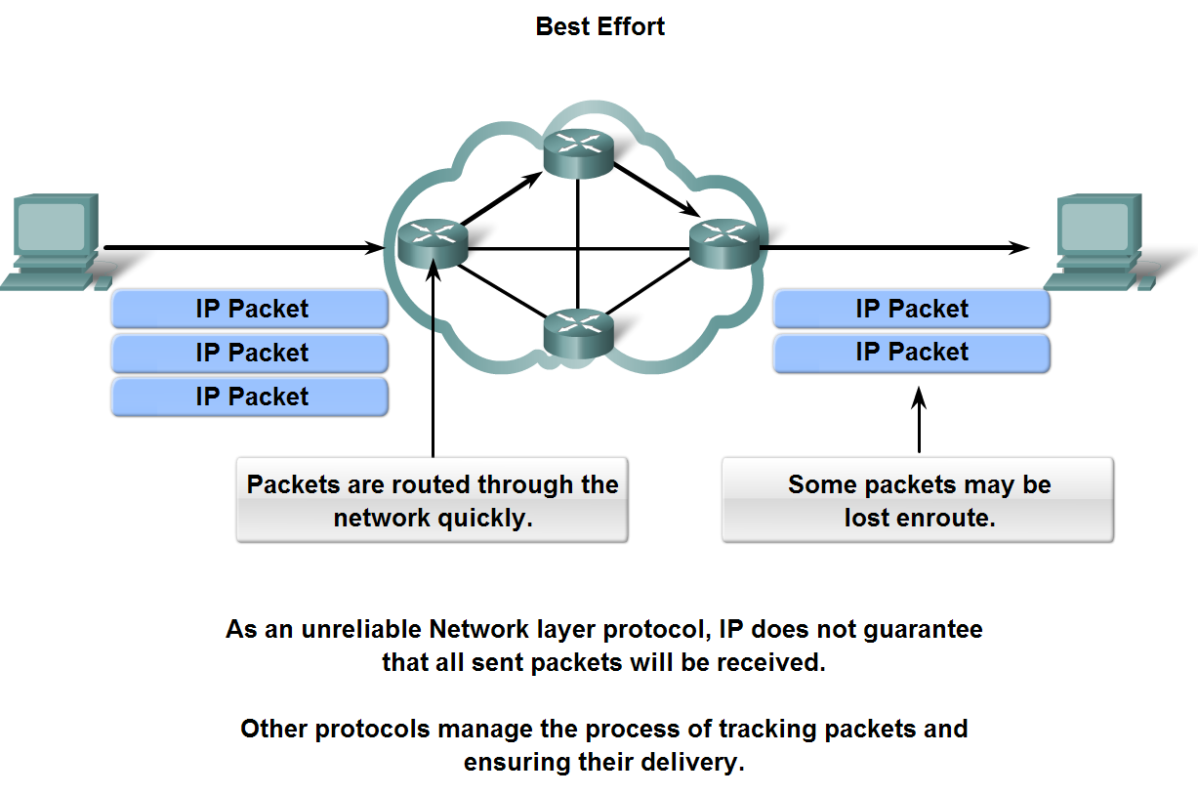
Internet Protocol (IP)
Best Effort Service (unreliable protocol)

Slide 10
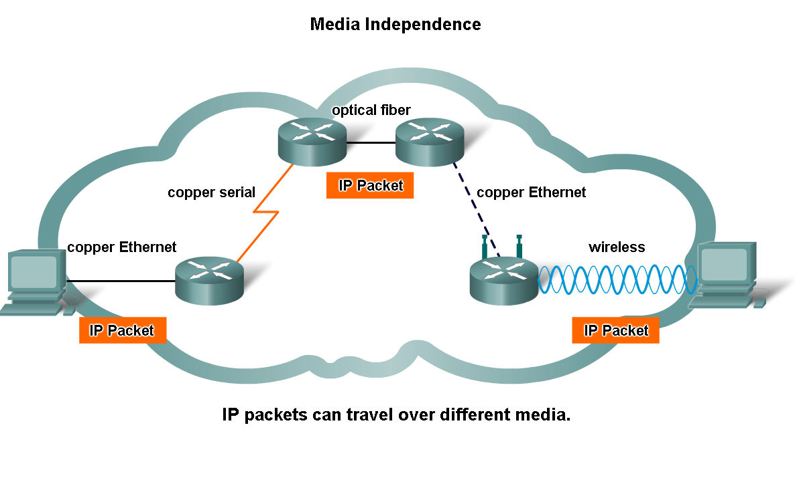
Internet Protocol (IP)
Media independent

Slide 11
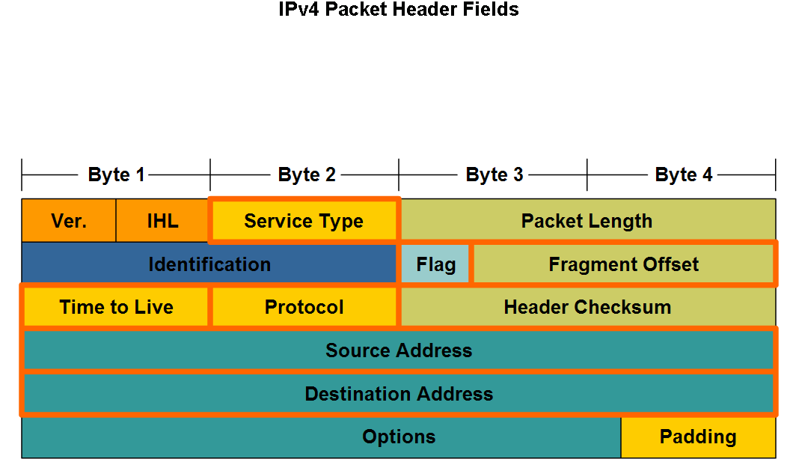
Internet Protocol (IP)
The major header fields in the IPv4 protocol: IP Source Address, IP destination Address, Time To Live (TTL), Type of Service, Protocol, Fragment Offset

Slide 12
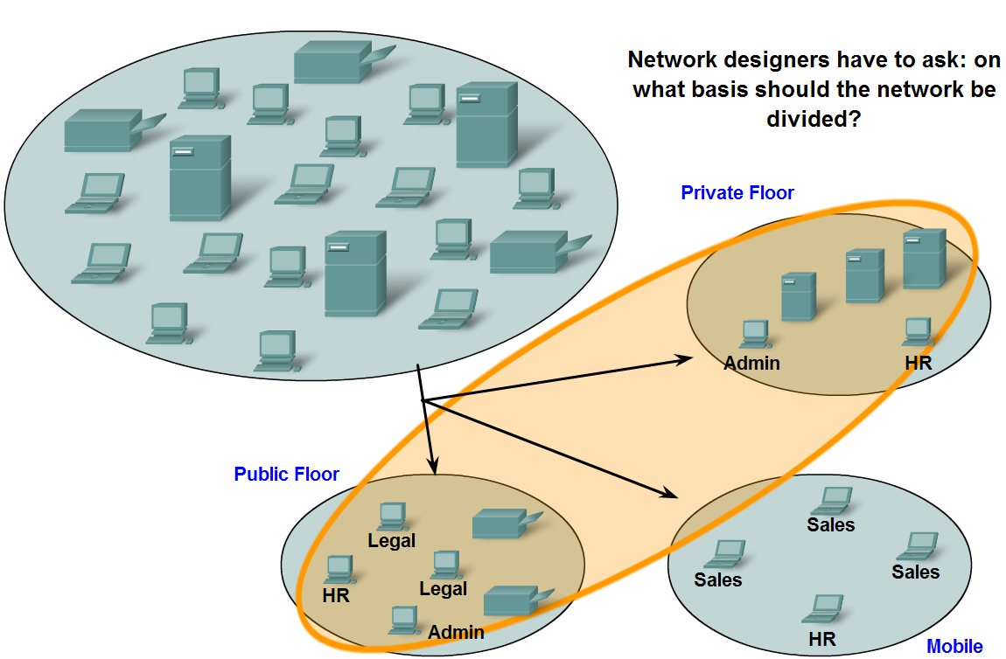
Grouping Devices into Networks and Hierarchical Addressing
Network can be grouped based on factors that include: Geographic location, purpose, and ownership

Slide 13
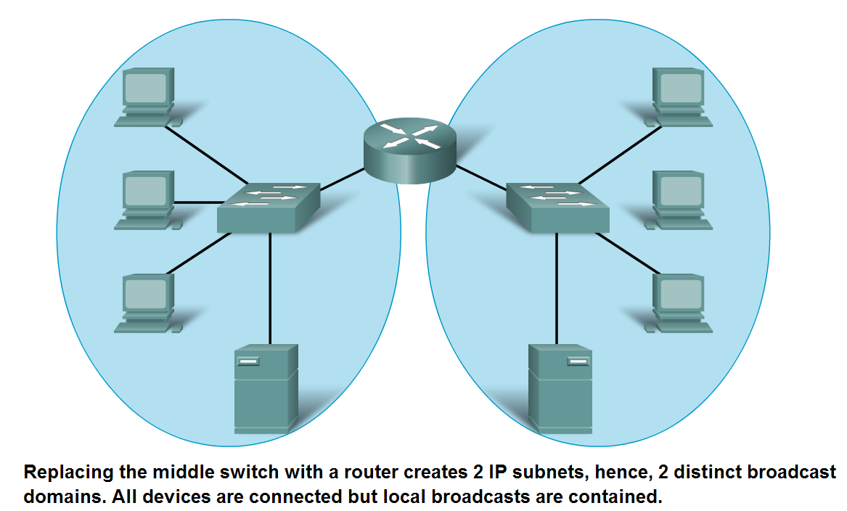
Grouping Devices into Networks and Hierarchical Addressing
Dividing a large network can increase network performance

Slide 14
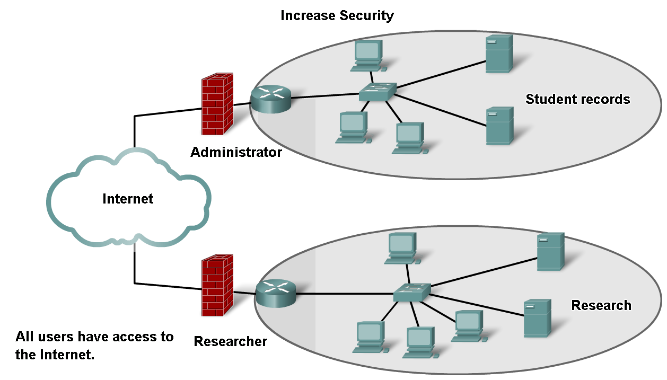
Grouping Devices into Networks and Hierarchical Addressing
Dividing a large network can increase network security

Slide 15
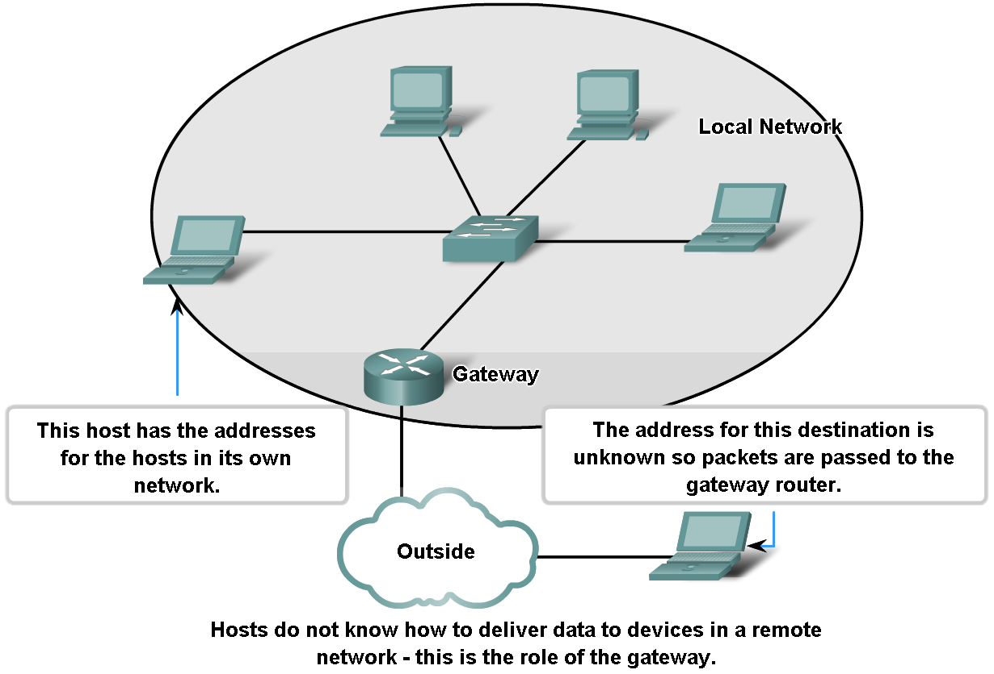
Grouping Devices into Networks and Hierarchical Addressing
Dividing network can improve Address Management

Slide 16
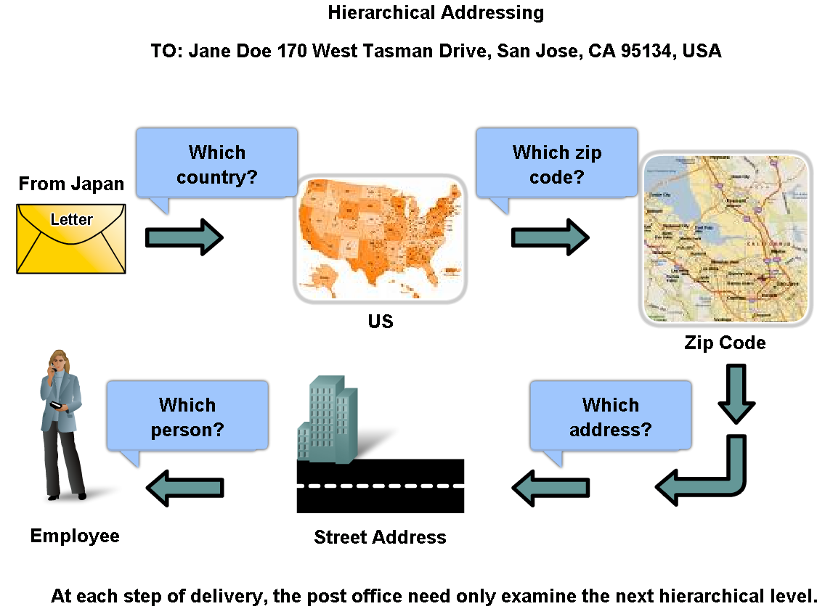
Grouping Devices into Networks and Hierarchical Addressing
Describe how hierarchical addressing solves the problem of devices communicating across networks of networks

Slide 17
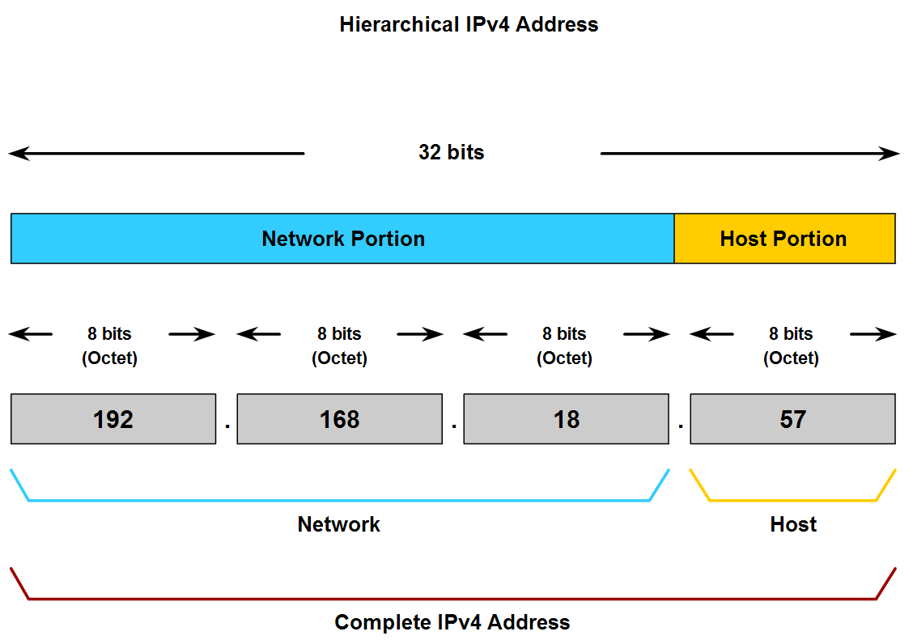
Grouping Devices into Networks and Hierarchical Addressing
Describe the purpose of further subdividing networks into smaller networks

